Slide 1
CSS
Cascading style sheet

Slide 2
CSS
CSS is the language we use to style and align our HTML elements.
CSS was introduced in 1994 by Haykon wium lie.
First version of CSS was introduced in 1996(CSS1)
CSS2-1998
Current version of CSS is CSS3-1999

Slide 3
Syntax of css
Css syntax:-
Selector{
Property:value ;
}
| | |
P{ color: blue }

Slide 4
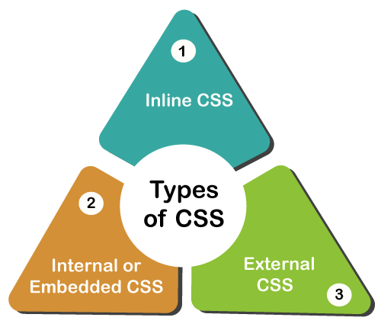
Types of CSS
It is style sheet language which is used to describe the look and formatting of documents written in markup language.
It is generally used with html to change the style of web pages and UI.
Commenting in css :-- /*-----*/

Slide 5
Three ways to add css file
1.Inline style sheet : Style attribute
<p style : ” color: red”>Hello CSS</p>
2.Internal style sheet : <style >tag
Example:
<style>
p{color : value}
</style>

Slide 6
External CSS Style
External style sheet==<link>tag
External css is used to apply css on multiple pages .
Extension must be .css for css files.
code
.CSS

Slide 7

Selectors

Slide 8
Types of CSS Selectors
Simple Selector
Combinator Selector
Attribute Selector
Pseudo class Selector
Pseudo Element Selector

Slide 9
Selector
A CSS selector selects the HTML element(s) you want to style.
Selector{
property: value;
property: value;
}

Slide 10
Simple Selector
Id selector (#)
Class selector (.)
Universal Selector (*)
Element Selector (tag)
Grouping Selector(,)

Slide 11
TYPE/ ELEMENT SELECTOR
Selects particular element.
Call by type of tag.
SYNTAX:
element name{
properties
}

Slide 12
UNIVERSAL SELECTOR(*)
Select any and all types of elements in html page.
All the elements within a body tag.
Symbol of selector: “ * “
SYNTAX:
*{
properties }

Slide 13
ID SELECTOR(#)
Unique id attribute within the page is selected
Core attribute selector
Selected by symbol “#” followed by id name
SYNTAX:
#id_name{
css properties
}

Slide 14
CLASS SELECTOR
Core attribute selector ,with specific class.
The character to access in css file “ . “
Multiple class name can be called using comma SYNTAX: . class _ name{
/* css properties*/
}
NOTE: PRIORITY ORDER =====
{ “ ID > CLASS > TYPE/ELEMENT >UNIVERSAL “}

Slide 15
COMBINATOR SELECTOR
A combinator is something that explains the relationship between the selectors.
Types:
Descendent selector(space)
Child selector(>)
Adjacent sibling selector(+)
General sibling selector(~)

Slide 16
DESCENDENT SELECTOR(Space)
The descendant selector matches all elements that are descendants of a specified element.
(parent,parents’s parent, parent’s parents’s parent)
Syntax: Selector1_Selector2{property declaration}
Div p{ prop:val;}

Slide 17
Child selector(>)
The child selector selects all the elements that are the children of a specified element
It is placed between 2 CSS selectors,matches only those elements matched by second selector and direct child.
Syntax:
selector 1 > selector 2 { properties }
Ex:
Div>p{prop : val}

Slide 18
Adjacent sibling selector(+)
The adjacent sibling selector is used to select an element that is directly after another specific element.
Sibling elements must have the same parent element, and "adjacent" means "immediately following".
Syntax :
former_element + target_element {style properties }

Slide 19
General sibling selector
The general sibling selector selects all elements that are next sibling of a specified element.
The general sibling combinator (~) separates two selectors.
Syntax :
former_element ~ target_element { style properties }

Slide 20
Attribute Selector
Attribute provides extra information to the tag.
In this attribute selector we are targeting the elements based on attributes
Selector[attribute]{
Property:value
}
EX:
[attr=value]:Represents element with an attribute name of attr whose value is exactly value.

Slide 21
Pseudo classes
A CSS pseudo-class is a keyword added to a selector that specify a special state of the selected element.
For Example: It can be used to
Style an element when a user mouses over it
Style visited and unvisited links differently
Style an element when it gets focus
Selector:pseudo-class{
property:value;
}

Slide 22
Pseudo Classes
Dynamic pseudo classes
Anchor Pseudo-classes
Link
Visited
Active
Focus
Hover
Structural pseudo classes
First-child
Last-child
Nth-child()

Slide 23
Pseudo Class SELECTOR
a:hover MUST come after we mouse hover on it
a:link and a:visited in the CSS definition in order to be effective.
a:active MUST come after
The :first-child pseudo-class matches a specified element that is the first child of another element.
The :last-child pseudo-class matches a specified element that is the last child of another element.
The :nth-child(n) selector matches every element that is the nth child of its parent.
n can be a number, a keyword (odd or even), or a formula (like an + b).

Slide 24
Pseudo Elements
A CSS pseudo-element is used to style specified parts of an element.
For example, it can be used to:
Style the first letter, or line, of an element
Insert content before, or after, the content of an element
selector::pseudo-element{
property:value;
}

Slide 25
Pseudo Elements
:: first-line
:: first-letter
::before
::after
::marker
::selection

Slide 26
Selector | Example | Example description
::after | p::after | Insert something after the content of each <p> element
::before | p::before | Insert something before the content of each <p> element
::first-letter | p::first-letter | Selects the first letter of each <p> element
::first-line | p::first-line | Selects the first line of each <p> element
::marker | ::marker | Selects the markers of list items
::selection | p::selection | Selects the portion of an element that is selected by a user

Slide 27
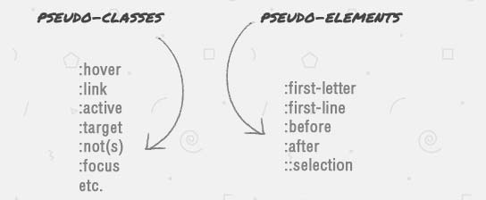
NOW WRITE THE DIFFERENCE BETWEEN
PSEUDO CLASS AND PSEUDO ELEMENT SELECTOR?!

Slide 28
Pseudo class v/s pseudo element
PSEUDO CLASS | PSEUDO ELEMENT
selectors are selected by “ : “ | selectors are selected by “ :: “
Pseudo-classes are used to target state. | Pseudo-elements are used to target specific parts of an element.

Slide 29
Text Property
Text formatting
Color
Text-align
Text-transform
Text-shadow
Text-decoration
Letter-spacing
Word-spacing
Text-indention

Slide 30
Background Property
Background-image : url (“image.jpg”)
Background-repeat : no-repeat/repeat-x/Y
Background-size : cover/100%
Background-Position : right/left/center
Background-attachment : scroll/fixed

Slide 31
Font Property
Font-size:large/small/medium
Font-weight:bold/bolder/lighter/normal
Font-style:italic
Font-family:font styles

Slide 32
color
Color: #efefef;
Color:rgb(255,255,0)
Color:rgba(rgba)

Slide 33

Gradient:

Slide 34
Gradient:
Linear-gradient(direction,color-stop1,color-stop2);
Radial-gradient(shape size at position, start-color,…,last-color);

Slide 35
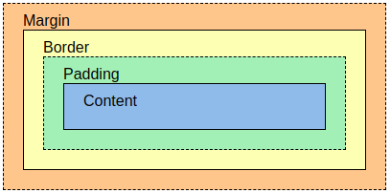
Box Model

Slide 36
Box model:
The CSS box model is essentially a box that wraps around every HTML element. It consists of: margins, borders, padding, and the actual content. The image illustrates the box model:
Content - The content of the box, where text and images appear
Padding - Clears an area around the content. The padding is transparent
Border - A border that goes around the padding and content
Margin - Clears an area outside the border. The margin is transparent

Slide 37
Properties
Margin-style
Margin-top
Margin-bottom
Margin-left
Margin-right
Padding-style
Padding-left
Padding-right
Padding-top
Padding-bottom
Border-style
Border-color
Border-width
Border-radius

Slide 38
Position Property
Static
Relative
Fixed
Absolute
Sticky

Slide 39
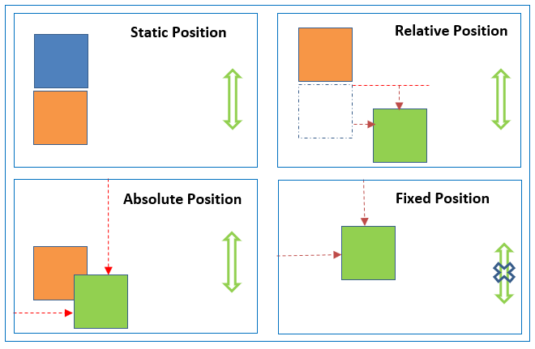

Slide 40
Display properties
Inline : Displays an element as an inline element (like <span>). Any height and width properties will have no effect
block : Displays an element as a block element (like <p>). It starts on a new line, and takes up the whole width
Inline-block : Displays an element as an inline-level block container. The element itself is formatted as an inline element, but you can apply height and width values
Flex : Displays an element as a block-level flex container

Slide 41
Flex Properties
Flex-box properties
Display : flex
Flex-direction: row/column
Flex-wrap: wrap/nowrap/wrap-reverse
Justify-content: flex-start/flex-end/center/space-around/space-between/baseline
Align-items: flex-start/flex-end/center

Slide 42
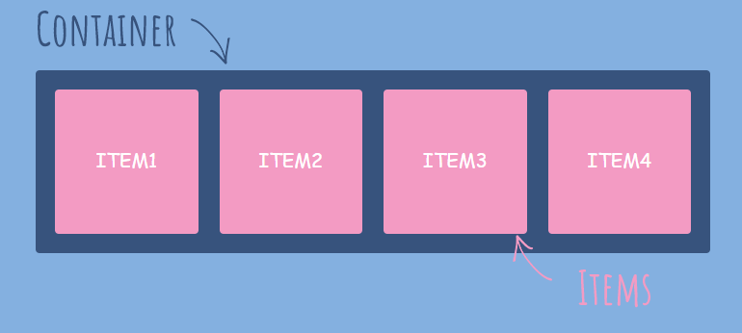
Flex-Box

Slide 43
Flex-items properties
Flex-basis:<length>
Flex-grow: <number>

Slide 44
Transition
Transition allows you to change property value.

Slide 45
Transition Property
CSS transitions allows you to change property values smoothly, over a given duration.
Transition-property: The CSS property you want to add an effect
Transition-duration: The duration of the effect
Transition-timing-function:
Transition-delay : The transition-delay property specifies a delay (in seconds) for the transition effect.
Transition(shorthand property)
transition: width 2s linear 1s

Slide 46
Transition-timing-function
ease - specifies a transition effect with a slow start, then fast, then end slowly (this is default)
linear - specifies a transition effect with the same speed from start to end
ease-in - specifies a transition effect with a slow start
ease-out - specifies a transition effect with a slow end
ease-in-out - specifies a transition effect with a slow start and end

Slide 47
2D and 3D Transforms
Transforms allow you to move, rotate, scale, skew, element.

Slide 48
Transform property
The transform property applies a 2D or 3D transformation to an element. This property allows you to rotate, scale, move, skew, etc., elements.
2D transform :
translate()
rotate()
scaleX()
scaleY()
scale()
skewX()
skewY()
skew()
3D transform :
rotateX()
rotateY()
rotateZ()

Slide 49
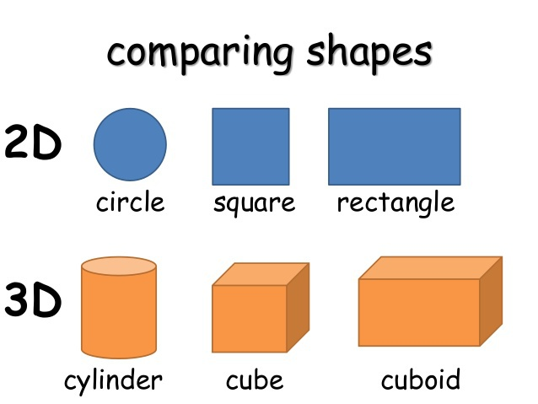
Difference

Slide 50
2D Transforms
1.translate()-moves an element from its current position.
2.rotate()-rotate an element clockwise/counter-clockwise according to degree.
Using negative values will rotate the element counter-clockwise.
3.scale()- increases/decreases the size of an element.
4.scaleX()-increases or decreases the width of an element.
5.scaleY()- increases or decreases the height of an element.
6.skew()-skews an element along the X and Y-axis by the given angles.
7.skewX()-skews an element along the X-axis by the given angle.[degree 0-360]
8.skewY()-skews an element along the Y-axis by the given angle.
9.matrix()- 6 parameters
mathematical function
matrix(scaleX(),skewY(),skewX(),scaleY(),translateX(),translateY())
transform: matrix(1, -0.3, 0, 1, 0, 0);

Slide 51
3D Transforms
rotateX()- rotates an element around its X-axis.
rotateY()-rotates an element around its Y-axis.
rotateZ()-rotates an element around its Y-axis.

Slide 52
Animations
CSS allows animation of HTML elements without using JavaScript or Flash!
An animation lets an element gradually change from one style to another.
You can change as many CSS properties you want, as many times as you want.
To use CSS animation, you must first specify some keyframes for the animation.
Keyframes hold what styles the element will have at certain times.

